Slide 1
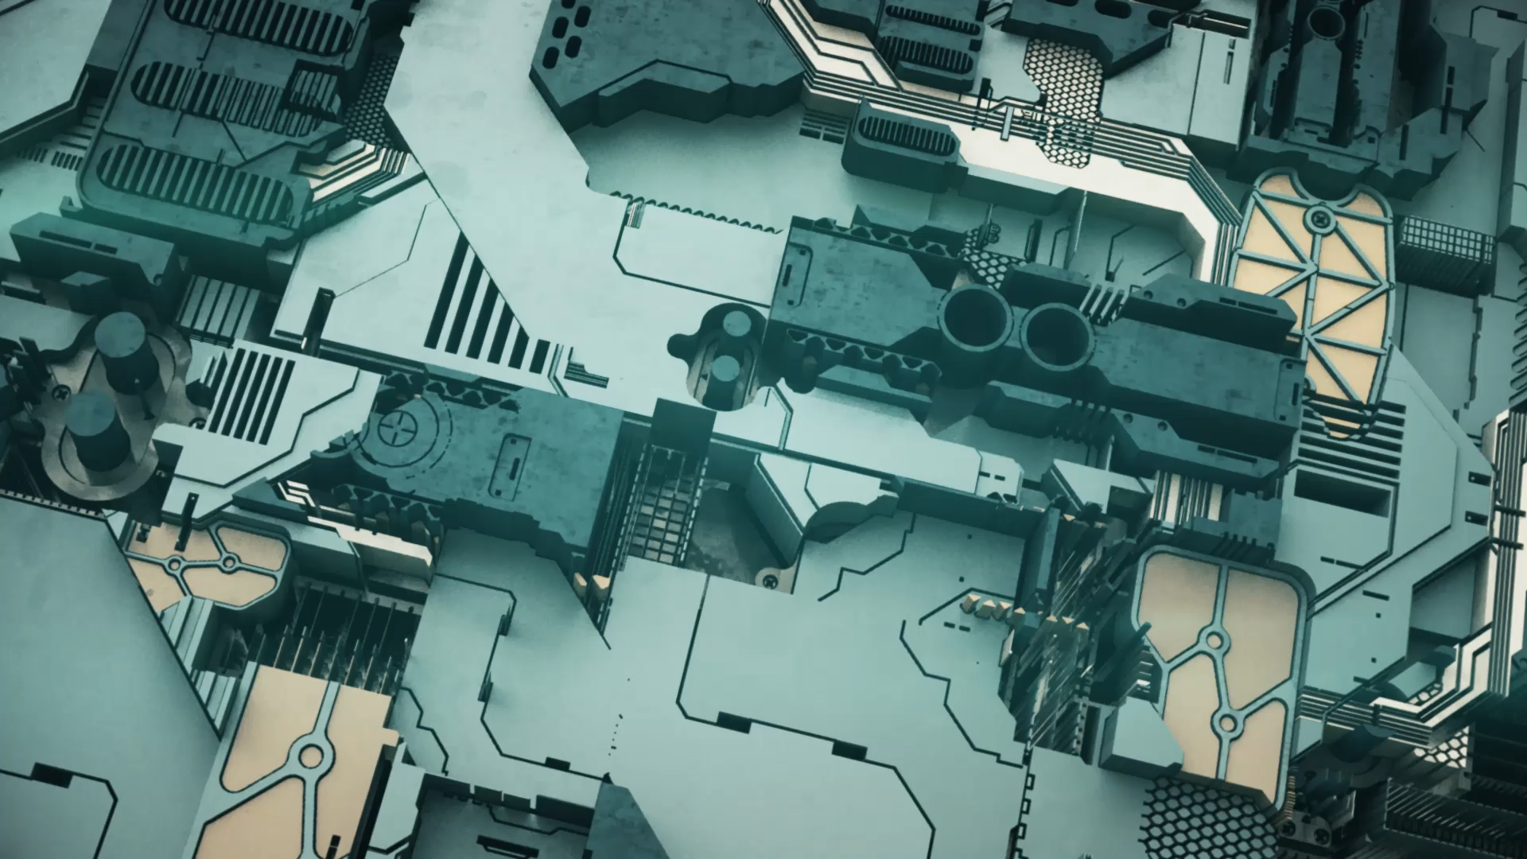
Architectural Design Pattern: Model-View-Controller
Muhammad Talah Khan FA20-BSE-042
Fahad Farman FA20-BSE-044

Slide 2

Intent
The intent of this design pattern is to help keep the user interface separate from the rest of the program.
or
The primary intent of MVC is to provide a clear separation of concerns within an application, enabling:
Modularity and Reusability
Scalability and Maintainability
Parallel Development
Testability
Notes:
Modularity and Reusability: Each component can be developed and maintained separately, promoting code reusability and easier modification without affecting other parts of the application.
Scalability and Maintainability: MVC's structure allows for easier scalability as new features can be added without major changes to the existing codebase. Additionally, it enhances maintainability by isolating changes within specific components.
Parallel Development: Different teams or developers can work on different parts (model, view, or controller) simultaneously without interfering with each other's work.
Testability: Separating concerns allows for easier testing of individual components, facilitating unit testing and ensuring robustness and reliability of the application.

Slide 3
Applicability
Use the MVC pattern when:
Complex User Interfaces: When dealing with applications that have intricate user interfaces, MVC helps in separating the concerns of data manipulation, user interaction, and presentation, making the codebase more organized and maintainable.
Multiple Device Support: MVC is beneficial when building applications that need to support multiple devices or platforms since it allows for different views to be created for different interfaces while sharing the same underlying model and controller logic.
Code Maintainability: For projects that require frequent updates or changes in the user interface without affecting the underlying data handling or business logic, MVC helps in maintaining the codebase by isolating these concerns.

Slide 4
Applicability contd
Parallel Development: When working in teams, MVC facilitates parallel development as developers can work on different components (Model, View, or Controller) simultaneously without disrupting each other's work.
Testing and Debugging: It aids in efficient testing as each component (Model, View, Controller) can be tested separately. This separation also makes it easier to identify and debug issues within specific parts of the application.
Reusability: MVC promotes code reusability as the separation of concerns allows for the reuse of models or controllers in different parts of the application or even in entirely different projects.
Scalability: When building scalable applications, MVC helps in managing complexity by organizing code into distinct components, making it easier to scale specific parts of the application independently.

Slide 5
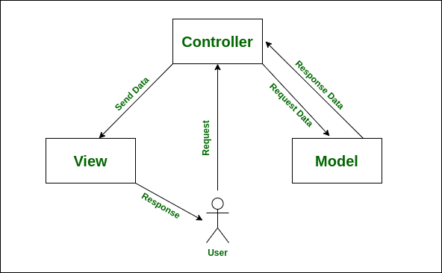
Structure Diagram

Slide 6
Participants
Model:
Represents the application's data and business logic.
Manages the data and responds to requests for information about its state.
Notifies the View of any changes in the data.
View:
Handles the presentation layer and the user interface.
Displays the data from the Model to the user in a specific format.
Receives user input (indirectly through the Controller) for further processing.
Controller:
Acts as an intermediary between the Model and the View.
Receives user inputs directly.
Manipulates the Model based on user inputs and updates the View accordingly.

Slide 7
Consequences
MVC promotes modularity by separating concerns, allowing for easier maintenance and updates to specific parts of the application without affecting the whole system.
The separation of concerns facilitates code reusability, where models or controllers can be used across different views or even in entirely different projects.
it enables teams to work on different components simultaneously, enhancing productivity and allowing for faster development cycles.

Slide 8
Consequences contd
While MVC promotes a clean separation of concerns, it can also introduce complexity, especially for smaller projects, where the overhead of implementing MVC might outweigh its benefits.
Improper implementation might lead to tight coupling between components, making the codebase more difficult to maintain and update.
In simpler applications, using MVC might introduce unnecessary complexity and overhead, making the codebase harder to manage.

Slide 9
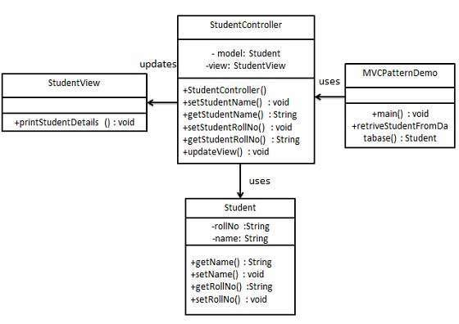

Base Example Implementation
We are going to create a Student object acting as a model.
StudentView will be a view class which can print student details on console.
StudentController is the controller class responsible to store data in Student object and update view StudentView accordingly.
MVCPatternDemo, our demo class, will use StudentController to demonstrate use of MVC pattern.

Slide 10
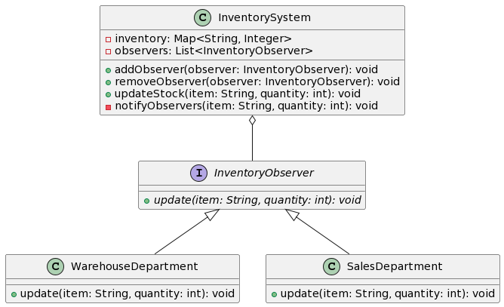
RealWorld2 Example Implementation
let's consider a scenario of an inventory management system. In this case, the Model will be an inventory system that notifies various departments or sections whenever the stock of a particular item changes.

Slide 11
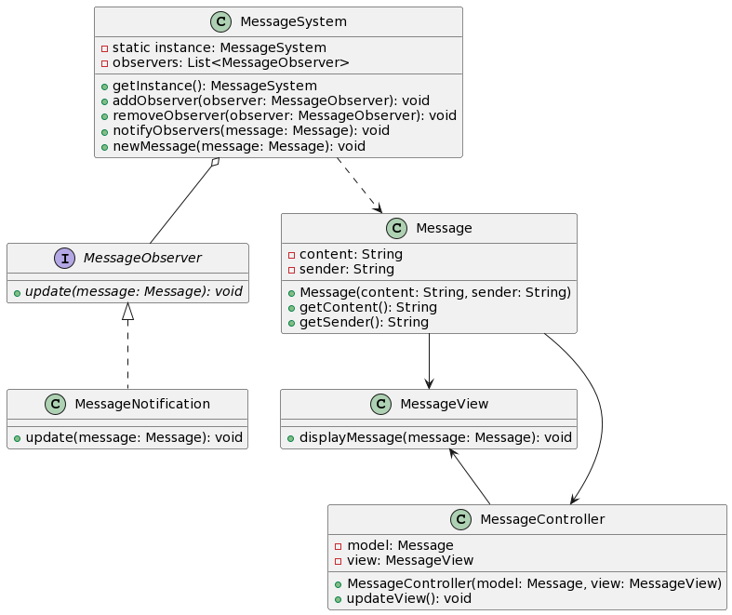
RealWorld5 Example Implementation
combining the MVC pattern with the Observer pattern and the Singleton pattern in the context of a messaging application. The MVC pattern will handle the user interface, the Observer pattern will manage the notifications for new messages, and the Singleton pattern will ensure a single instance of the messaging system.

